Slide 1
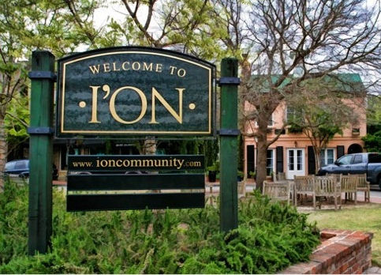

Slide 2
Civitas Award 2012
For Outstanding Community Service
Making I’On a Better Place to Live
2012-????

Slide 3
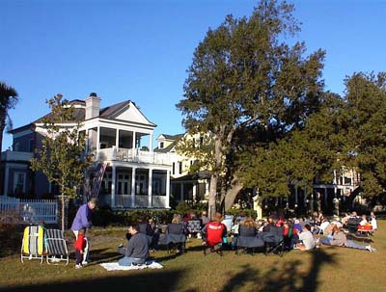

Slide 4
Civitas Award 2012
For Outstanding Community Service
Making I’On a Better Place to Live

Slide 5
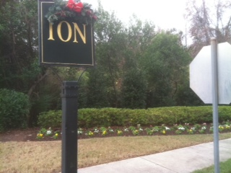
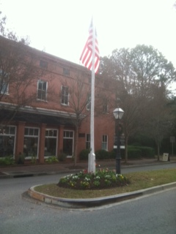
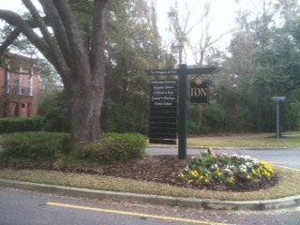

Slide 6
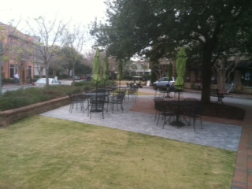
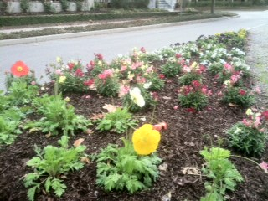

Slide 7
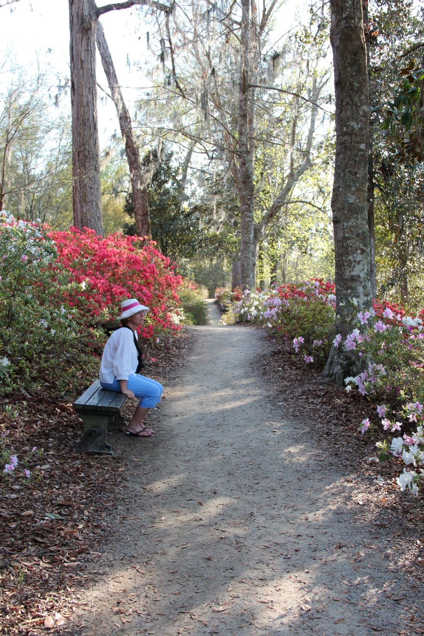
Landscape Committee
Does the Seasonal Color
Round About Planning
Guidance for Lawn-O-Green
“Always willing to work”

Slide 8
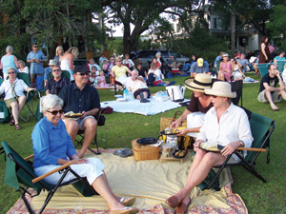
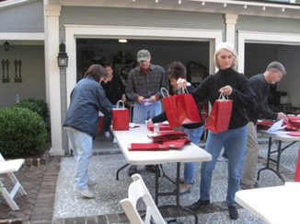
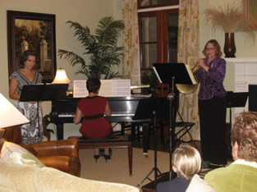
Street Campaigns
Programming Work
Executive Committee
I’On Trust

Slide 9
“Quotes”
“She helps everywhere and does more than expected”
“Her programming and volunteer efforts for the Trust events is well known”
“She helps everywhere without being asked”
“Many times I have seen her in the hood directing Lawn O Green”
“She quietly arranges for the Screen on the Green”
“She doesn’t know how to say no”

Slide 10
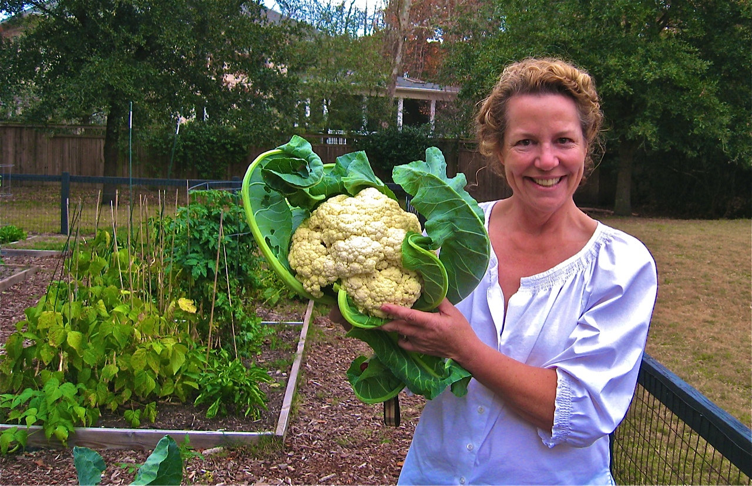
Amy Sage Civitas Award 2012

Slide 11
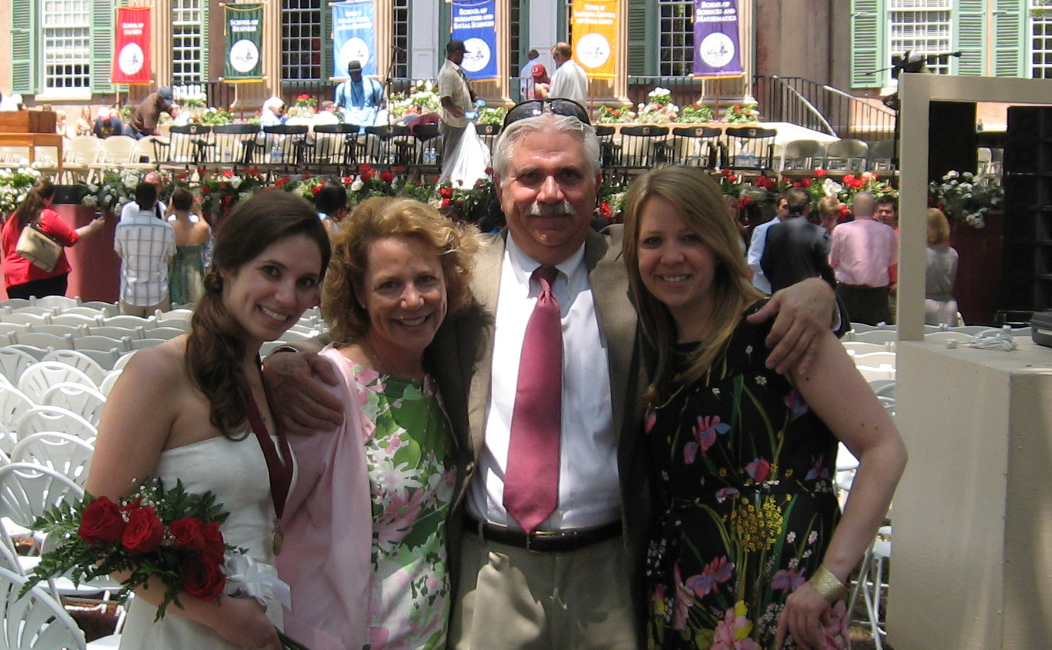
Amy and husband, Bill with daughters Hattie & Elizabeth

Slide 12
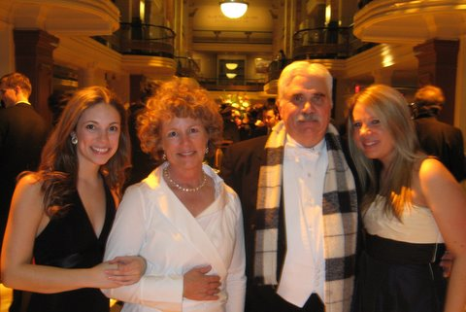
Amy and husband, Bill with daughters Hattie & Elizabeth

Slide 13
Amy Sage Civitas Award 2012

